Slide 2
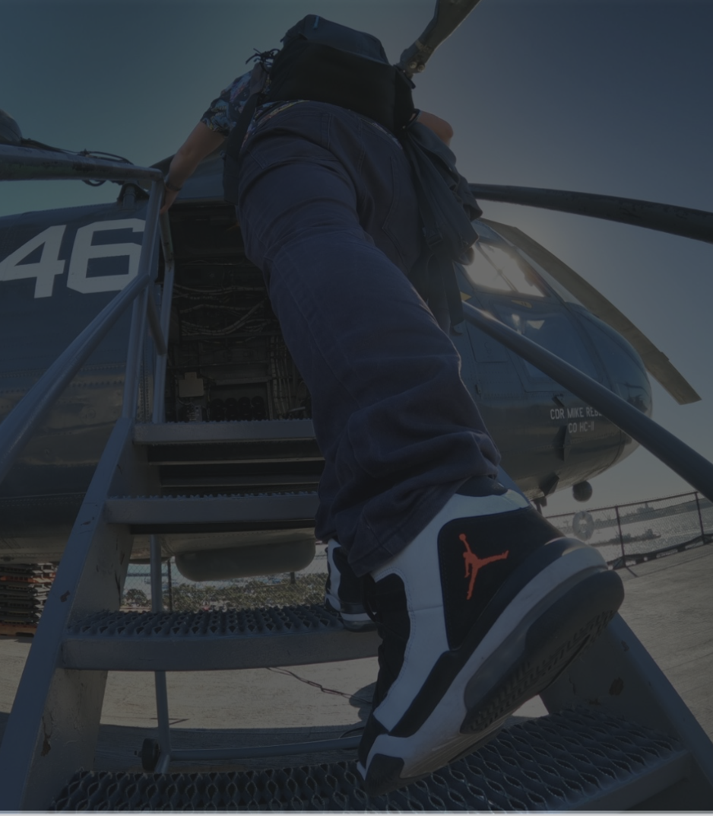
Agenda
GoPro moment
Hero to storytelling
AI Editing
Cloud infrastructure

Slide 3
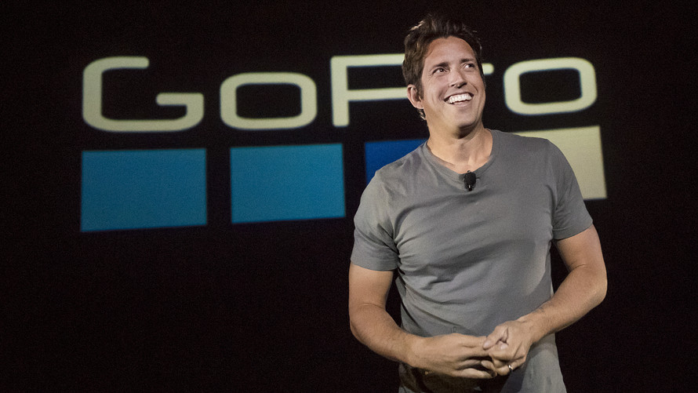
极限运动 + 社牛
Collect your moments instead of things, make friends
GoPro action camera
小巧坚固
高画质
电子防抖
Nick woodman

Slide 4
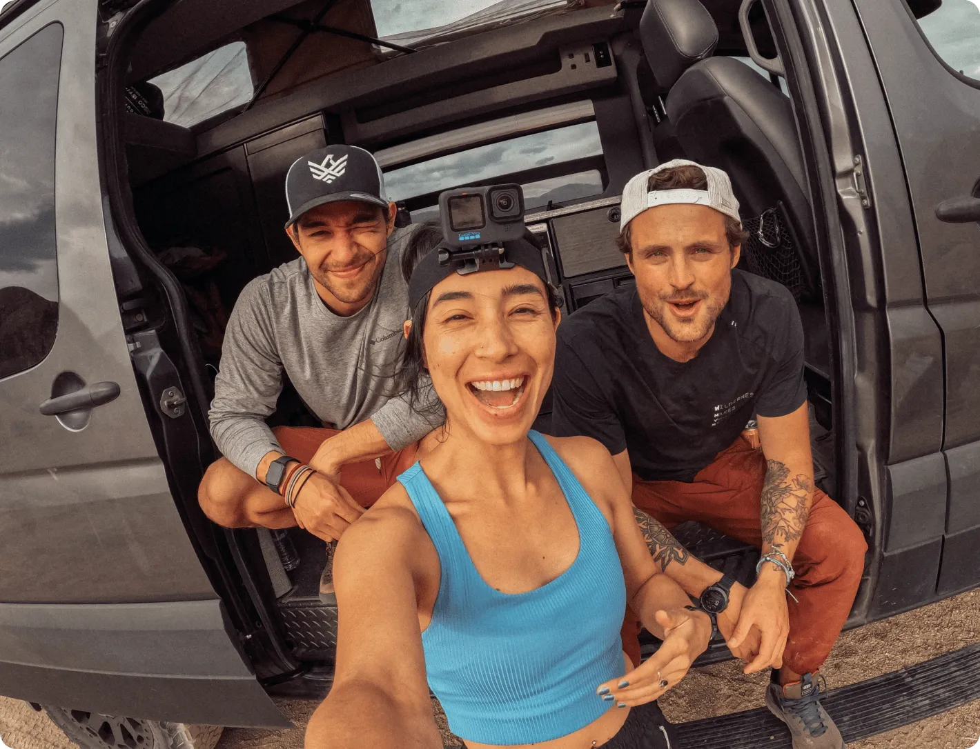
Hero to storytelling 极限运动到讲故事
footage capture
Media analysis (GPMF metadata)
Highlight moment
Music sync
Transitions

Slide 5
AI editing
Footage selection (auto trim, Key frame, tracking, object detection)
Train own GEN AI model
Prompt EDL (editing decision list)

Slide 6
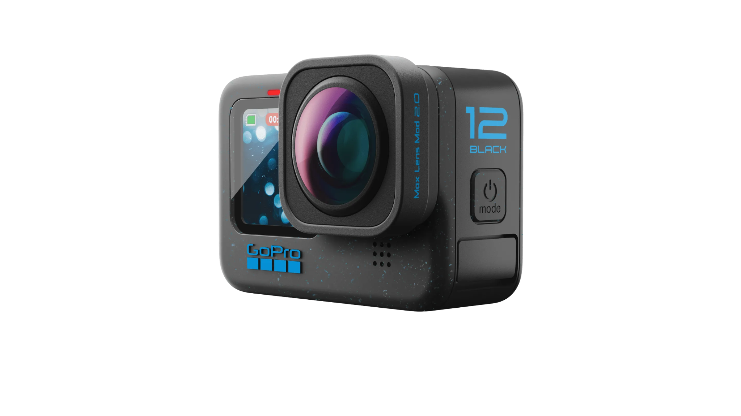
Cloud infrastructure
Multiple region
Data intensive backend
Highly auto-scaling
GoPro hackathon
December
AI projects

